Slide 1
Jira
Confluence
and something else

Slide 2


Agenda
JIRA
Why
How
Tools
Confluence
Why
How
Tools
External Links

Slide 3
Jira

Slide 4
Why
Managers need to plan a project
Devs need to focus on one task
Everybody needs to track status of a project
Leave No Data Behind

Slide 5
How
Task tracker App: prioritisation and visibility
Plan the roadmap: milestones, due dates, work load
Report: Review historic data to take decisions and estimate better

Slide 6

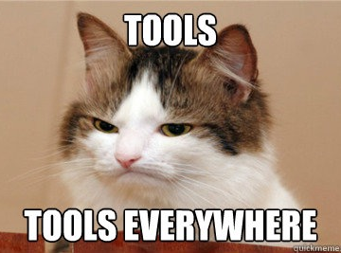
Tools
Projects
Issues
DashBoards
Agile

Slide 7
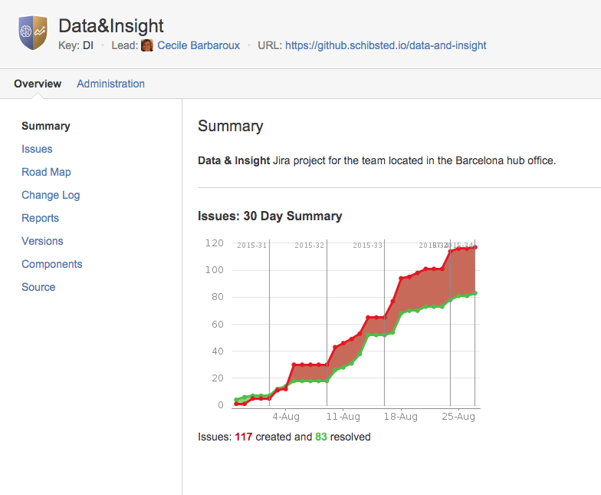
Projects
It’s a group of Issues
Plus a set of configurations
Versions: released / unreleased
Components: modules

Slide 8

Issues
Types
Fields
Priority
Workflow
Search

Slide 9
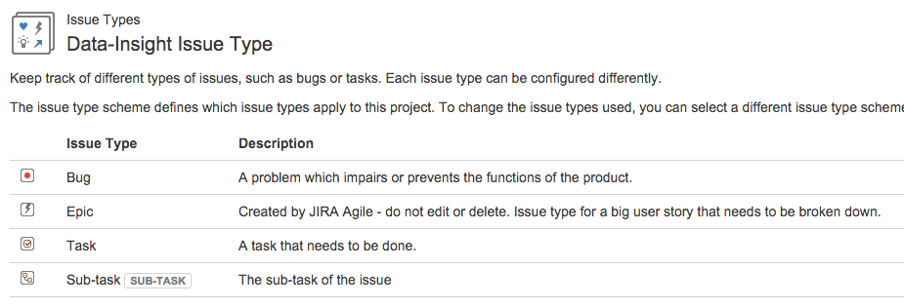
Issue Types
Bug
Epic
Task
Sub-Task
…
Story
Improvement
Test
Custom Made

Slide 10
Issue Fields
Text
Tags
Dates
Select
System
Priority
Status
Resolution

Slide 11
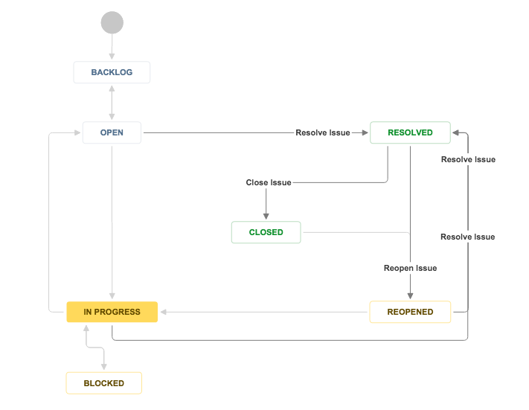
Issue Workflow
Customisable Workflows
Transitions are important
Start Progress
Stop Progress
Resolve Issue
Reopen Issue
Updates Status

Slide 12
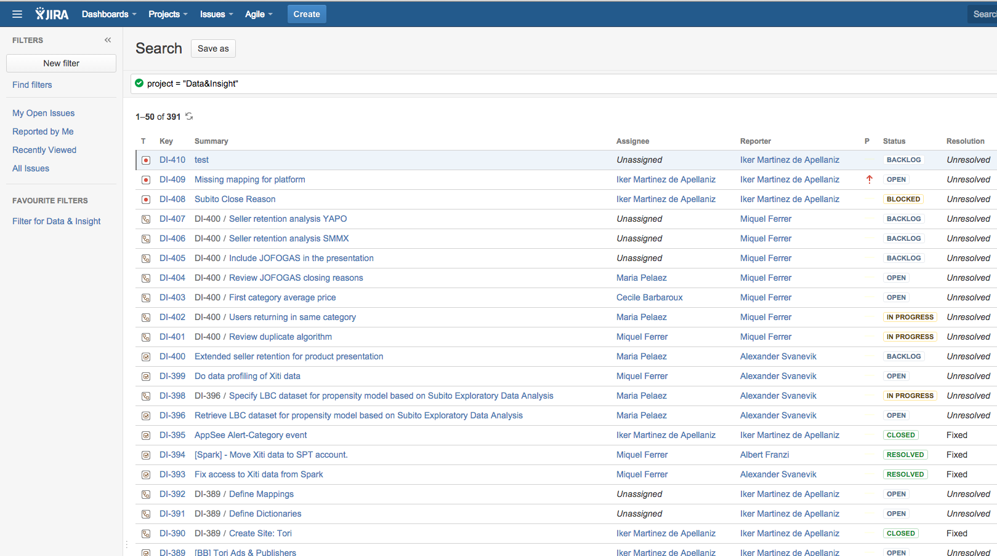
Issue Search
Quick
Basic
Advanced
jql
Bulk Change
Save & Share
Live Demo

Slide 13
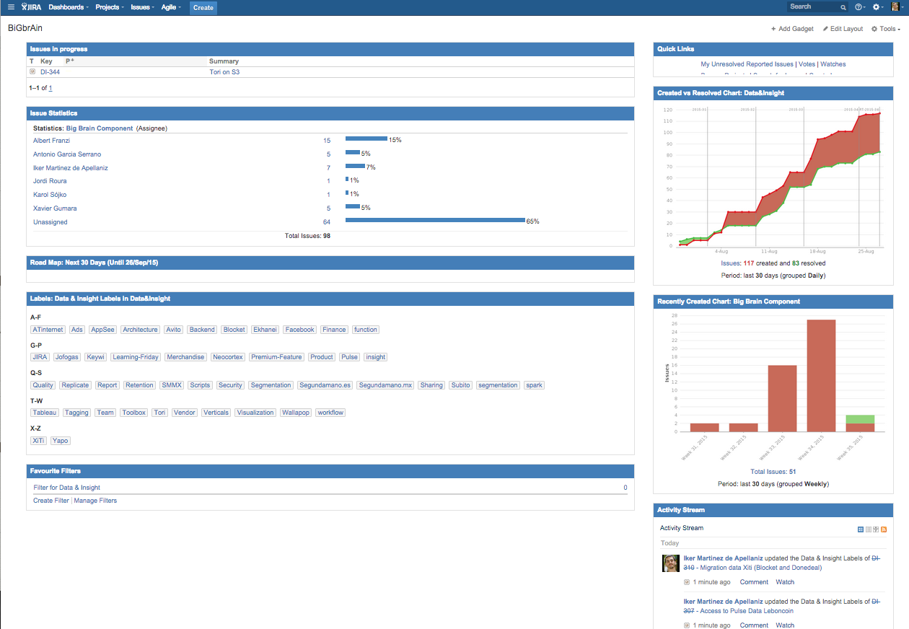
Dashboards
Graphical presentation of …
Private or Public
Multiple Gadgets
Graphs, tags, filters, streams,
Wallboard

Slide 14
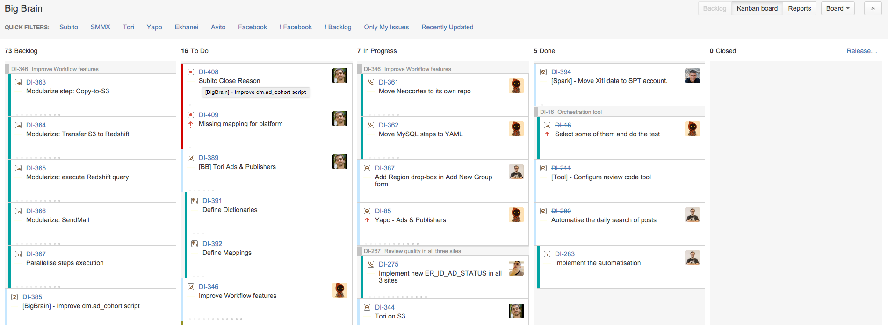
Agile
Visual layer to do Kanban or Scrum
One Screen view of full project

Slide 15
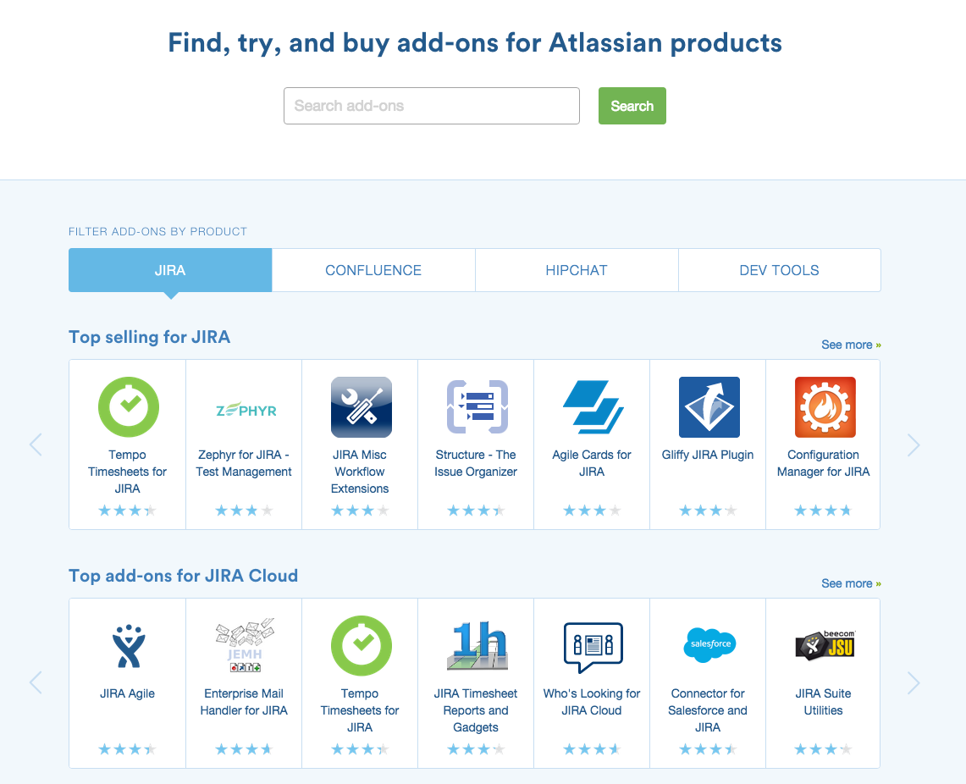
Other Nice Things
Collaboration with @
Watch / Notify
Reports
Plugins: Tempo, Structure, …
Integration with GitHub, fishEye, …
HotKeys

Slide 16

Demo time

Slide 17
Confluence

Slide 18
Why
Need to keep documentation alive
It has to be easy
Single point of failure
Collaborative
Leave No Data Behind

Slide 19
How
Spaces & projects
Mentions and Colaboration
Version Control
Plugins and Extensions

Slide 20

Spaces

Slide 21
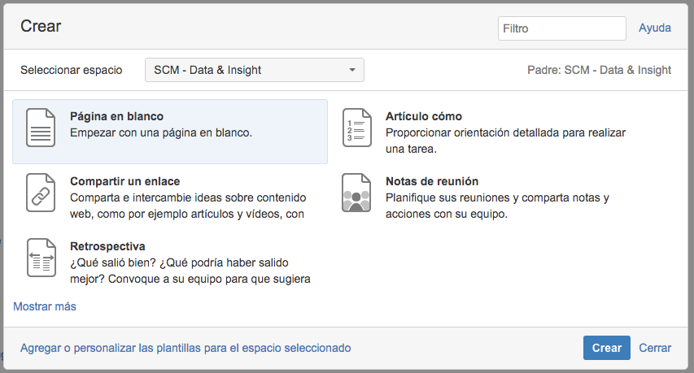
Pages
Templates to makes things consistent & fast
Custom templates
Widgets & macros
Collaborate over a page section, text, …
Restrictions
Like

Slide 22
Let’s create:
A blog entry for today’s event
A retrospective
Edit the Learning Friday’s page
Spam some people

Slide 23
Jira
+
confluence
+
GitHuB
+
FishEye
+
Crucible

Slide 24
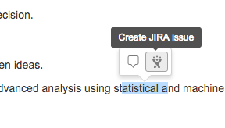
Atlassian Products
Atlassian products are widely integrated
You can create an issue for a comment on confluence
Create a report on confluence for a Jira release
Show crucible code reviews on Jira
Release to Prod with bambu
….

Slide 25

Integration with other tools
Show github branches on jira
Create branches for tasks directly from jira (plugin)
Release with external tools (plugin)
Make your own plugin to integrate with jira or search in the marketplace

